Slide 1
Chapter 2_part 2
Hardware components

Slide 2
Chapter Objectives
By Completing this chapter, you should be able to:
Identify the main hardware components of the computer.
Understand the role of CPU and its major components
Differentiate between types of computer memories.
Understand how data is stored in computer.
List the major storage measures.
Convert between memory units.
Differentiate between CPU and GPU computation measures.
Distinguish between throughput and latency measures.
Discuss the effect of electricity consumption of the computer devices

Slide 3
The Central Processing Unit CPU
Is the electronic circuitry that executes instructions based on an input of binary data (0’s and 1’s).
The CPU main components are:
Control Unit (CU)
Arithmetic and Logic Unit (ALU)
Registers (Immediate Access Store)
Notes:
These components are all wired in very specific ways in order to process data.
It is important here to remember that data, to our hardware, is a series of binary, on and off, electrical pulses.
These pulses are run through different wires, semiconductors, and components as a means to process and return data that is usable by the software.

Slide 4
Control Unit (CU)
Responsible for controlling and monitoring the input and output of data from the computer’s hardware.
Receiving instructions from the software and running the show.
Making sure that data is sent to the right component, at the right time, and arrives with integrity.
keeping all the hardware working on the same schedule. It sends a regular electrical signal to all components at the same time to coordinate activities.

Slide 5
The Arithmetic and Logic Unit (ALU)
Is where all the arithmetic and logical operations takes place on your computer.
Arithmetic operations that deal with calculating data (e.g. 5 * 4 = 20)
Logic operations that deal with comparisons and conditionals (e.g. 25 > 10)

Slide 6
Registers
The register, or immediate access store, is limited space, high-speed memory right on the CPU that can use for quick processing.
They provide the CPU with a place to store and access values that are crucial to the immediate calculations the ALU is processing.

Slide 7
Random Access Memory (RAM)
Is a high-speed memory that a computer uses to store and access information on a short-term basis.
Computer’s performance can be directly correlated to the amount of RAM it has available to use.
Is considered primary volatile memory, which means it loses whatever is stored on it as soon as power is disconnected.

Slide 8
Buses
Is an engineering term for a job-specific high-speed wire.
These wires are often group together in bundles and will transfer electrical signals either in parallel or in serial.
Buses can be grouped into three functions:
Data buses,
Address buses
Control buses.

Slide 9
CPU main components
Data buses are bidirectional and carry data back and forth between the processor and other components.
Address buses are unidirectional and carry a specific address in memory.
Control buses are unidirectional and are responsible for carrying the control signals of the CU to other components as well as the clock signals for synchronization.

Slide 10
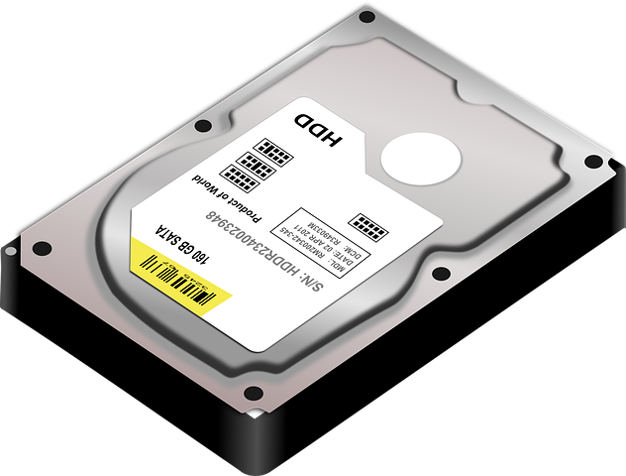
Hard Disk Drive (HDD),
Is responsible for the long-term, or secondary storage of data and programs. This is an example of non-volatile memory, meaning that it will retain its information when we shut down our computer.

Slide 11
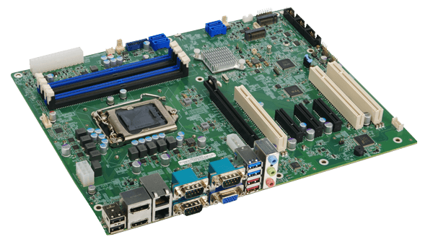
Mainboard
The mainboard, or motherboard, is a printed circuit board that houses important hardware components via ports.
The CPU, the HDD, various USB devices, and more are connected through ports on the mainboard.
The mainboard allows these components to communicate easily.

Slide 12
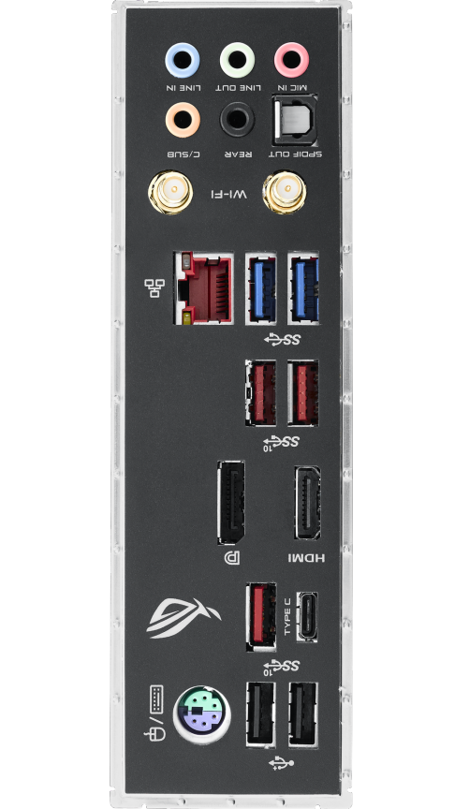
Ports
A port is a physical outlet used to connect outside, IO (Input/Output) devices to a computer. A computer typically contains multiple ports. This connection allows for communication between the IO device and our computers. Examples of IO devices include keyboards, mice, and monitors.

Slide 13
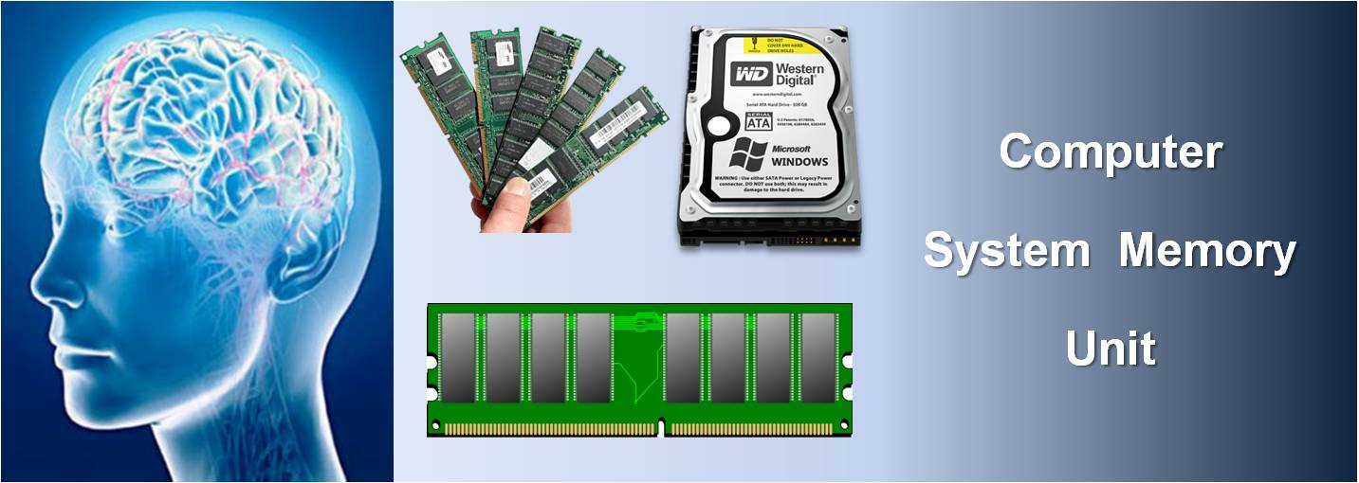
How computer features are measured and compared?

Slide 14
Data representation
A bit (the binary digit), makes up the smallest unit of data for computers.
Bit unit can only have one of two values: 0 or 1, usually to represent if an electronic signal is on or off.
These groupings of 8 bits has a special name, a byte.
Bytes serve as the more common unit with unit prefixes to represent more workable amounts of data.

Slide 15
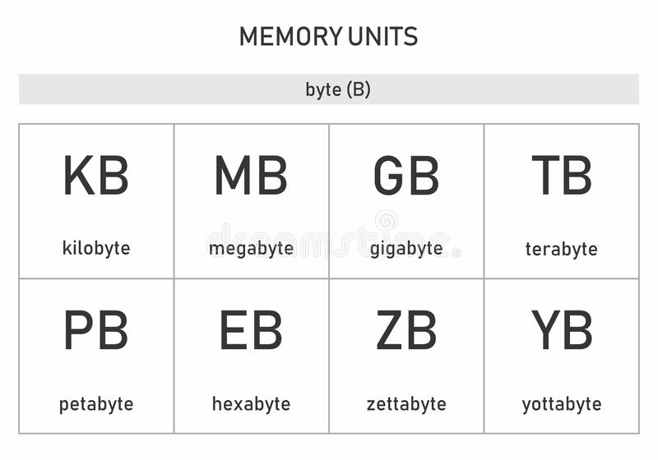
Memory units

Slide 16
Memory units: value, name and example
Value | Name (Abbreviation) | Example
1000 Bytes | Kilobyte (kB) | A typical email (~2kB)
1000² Bytes | Megabyte (MB) | A novel (~1.5MB) or 1 song (~5MB)
1000³ Bytes | Gigabyte (GB) | A 1080p movie (5GB)
1000⁴ Bytes | Terabyte (TB) | Entire major libraries
1000⁵ Bytes | Petabyte (PB) | All the data held by a major tech company

Slide 17
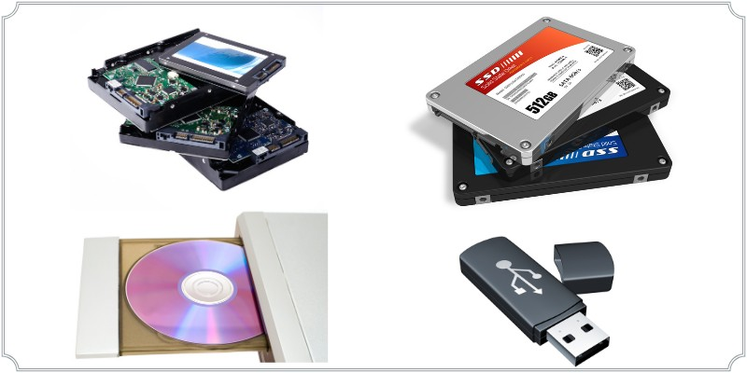
Measuring storage performance
These file sizes lead into the importance of storage performance.
Throughput: is the total amount of data that can be transferred during a given amount of time.
Long-term storage (hard drives)
Are able to reach read and write speeds of over 5000 megabyte per second (mbps).

Slide 18
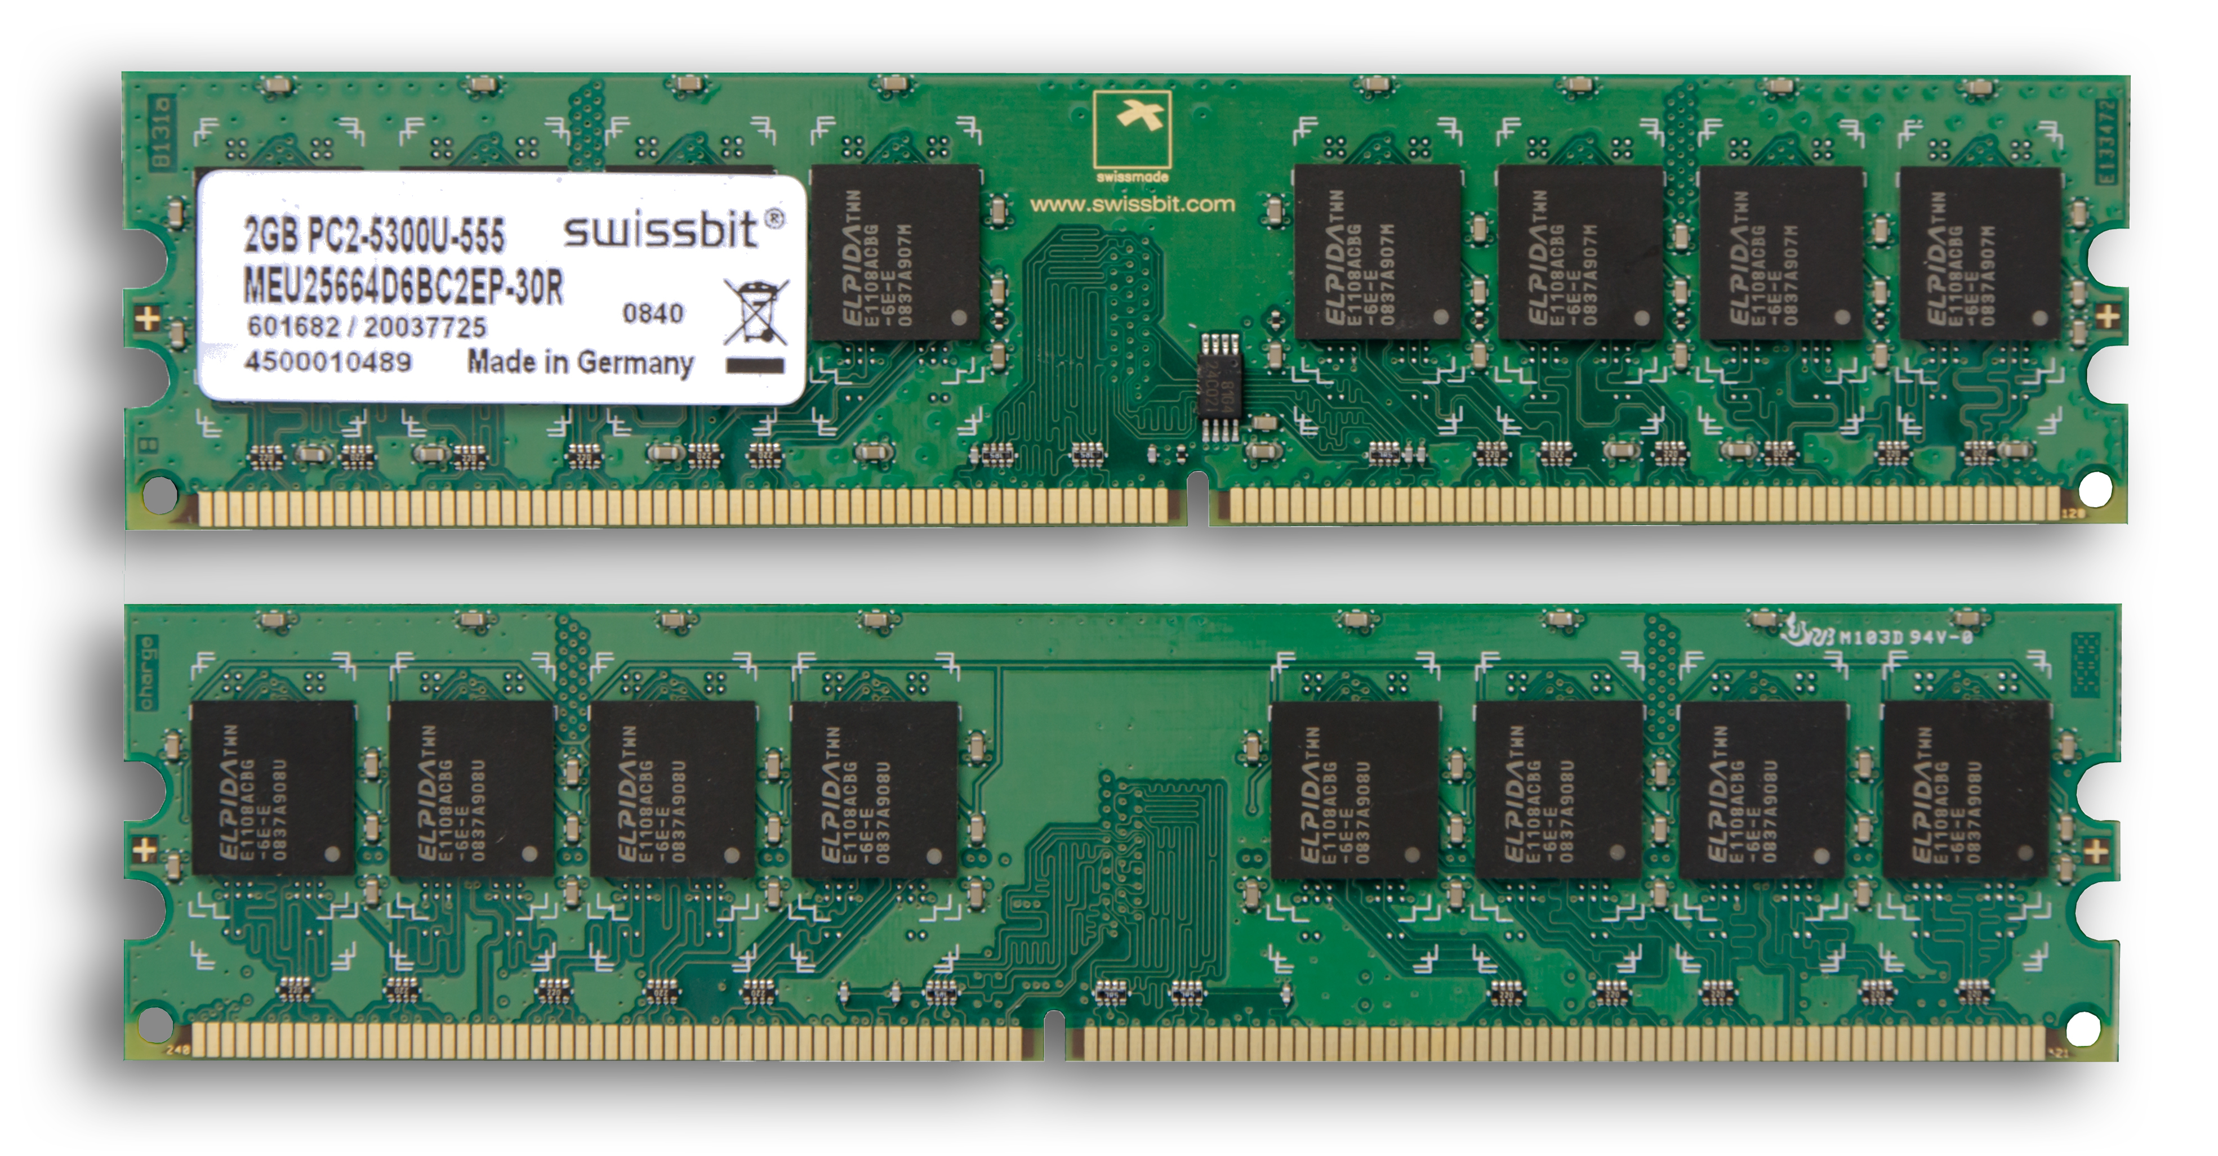
Measuring storage performance
These file sizes lead into the importance of storage performance.
Short-term storage ( Random Access Memory RAM)
Is much faster. The speed of RAM is typically around 20,000 mbps.

Slide 19
Measuring storage performance
Latency: the amount of delay before that transfer of data begins.
Newer RAM devices usually have latency of around 10 nanoseconds.
The fastest of solid-state drives (SSDs) have latency times of a few microseconds, or almost 1000 times slower!

Slide 20
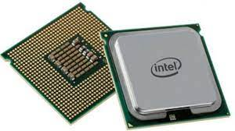
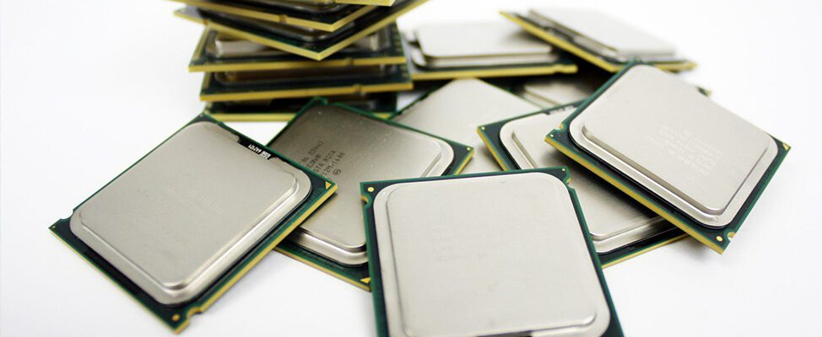
Measuring computation performance
Central Processing Unit (CPU)

Slide 21
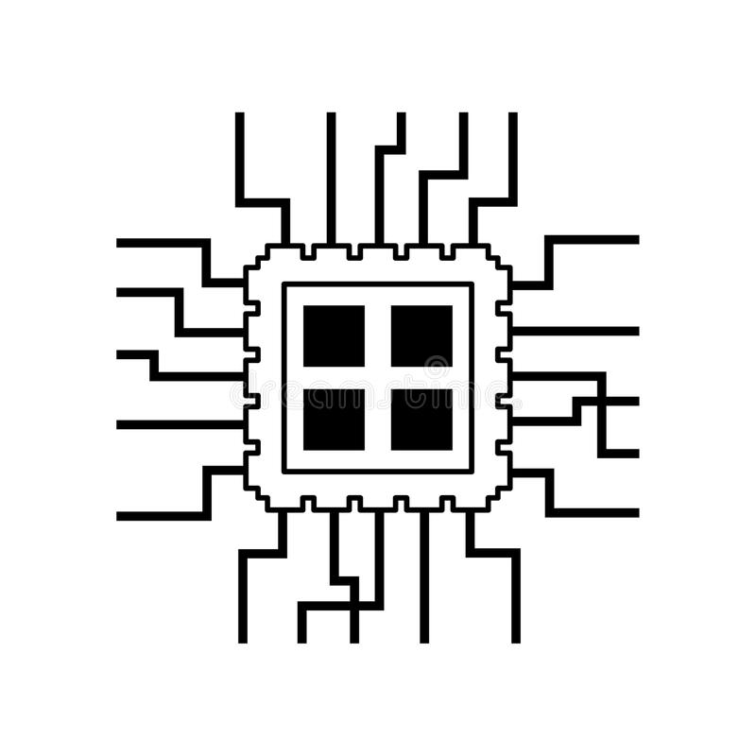
Measuring computational performance
A clock speed of CPU determines how quickly it can do computations.
Ex. (3.5GHz ) or 3.5 billion operations per second.
Problem: the physical limitation in the durability of silicon.
Solution: a more important measure is the number of cores a CPU contains.
Each core within a CPU can do one computation at a time.
A CPU with four cores can simultaneously do four times as many computations as a CPU with one core.

Slide 22
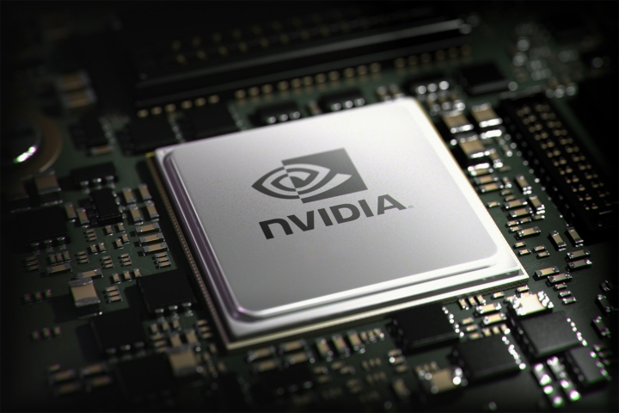
Measuring computation performance
Graphical Processing Unit ( GPU)

Slide 23
Measuring computation performance
GPUs are similarly measured to CPUs, as they are both devices focused on computations.
However, with the GPU’s different goal of computing graphics comes different implementations.
They tend to have many more computational cores (up to 80!), but with much slower clock speeds (around 2GHz).

Slide 24
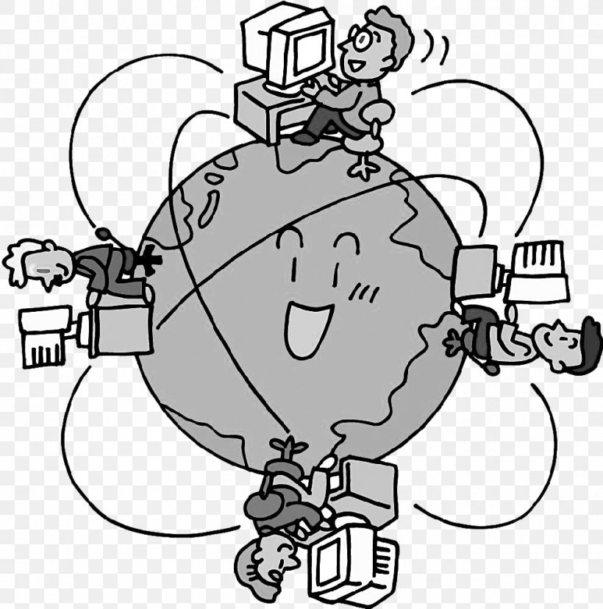
Measuring Internet performance
Measures of Internet devices consist of the entire “pipe” that attempts to bring the data to a device.
Everything from the speed of the server providing the data, the miles of cables connecting it to an Internet service provider (ISP), and all of the similar connections until it reaches the desired device make up this measure.
These speeds are decided by the slowest device along the entire chain.
net performance

Slide 25

Measuring electricity usage
More powerful devices tend to use more energy.
This energy is measured in watts.
Power consumption has two effects:
Over time the cost of electricity can eclipse the cost of the actual device.
All of the energy taken in by a device is dissipated as heat. This needs complex cooling solutions to best maintain performance.
يتم تبديد كل الطاقة التي يستهلكها الجهاز على شكل حرارة. هذا يحتاج إلى حلول تبريد معقدة للحفاظ على أفضل أداء.

Slide 26
Wrapping up
We discussed role of CPU and its major components
We explained the difference between registers and RAM and HDD.
The performance of any data transfer is measured in the throughput and latency of this data.
Throughput is the total amount of data that can be transferred in a given amount of time.
Latency is the amount of delay before that transfer of data begins.
Both CPUs and GPUs have similar measures for computation performance.
The energy devices use is measured in watts. The greater the wattage, the greater the amount of heat the device creates.

